Slide 1
Social Buzz
Data Analysis
Presented by Data Analytics Team

Slide 2
Agenda
Project recap
Problem
Analytics Team
Process
Insights
Conclusion

Slide 3
Project Recap
Problems
Big data that has not been analyzed
Guidance to ensure a smooth IPO
Lack of experienced human resources
Objectives
Audit big data
Recommendations for a successful IPO
Top 5 categories with the largest popularity

Slide 4
Analytics Team
ANDREW FLEMING
Chief Technology Architect
MARCUS ROMPTON
Senior Principal
MACIE NGUYEN
Data Analyst

Slide 5
Process
Step 1
Step 2
Step 3
Step 4
Step 5
Data Understanding
Data Cleaning
Data Modelling
Data Analysis
Data Visualizations & Recommendations

Slide 6
16
1897
January
Unique Categories
Reactions to Animal Posts
Month with the most posts

Slide 7
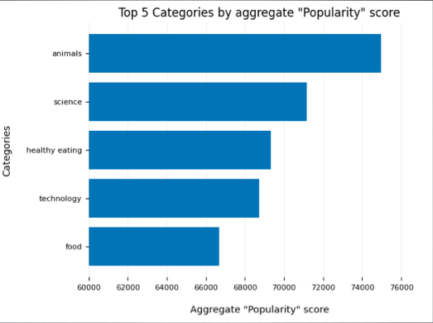
Figure 1

Slide 8
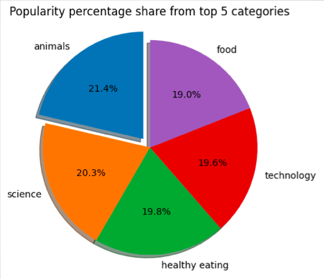
Figure 2

Slide 9
Conclusion
Next steps
Animal and Science are the two most popular category => User enjoy real-life and factual content.
Food is common theme with the top 5 categories with “Healthy Eating” ranking the highest => Collaborate with healthy food brand to boost user engagement.
Take a large scale production analysis for real-time understanding.

